Slide 1
Using Abortion Provision and Health Care Coverage to Predict the Number of Crisis Pregnancy Centers in a State
Marjorie Crowell

Slide 2
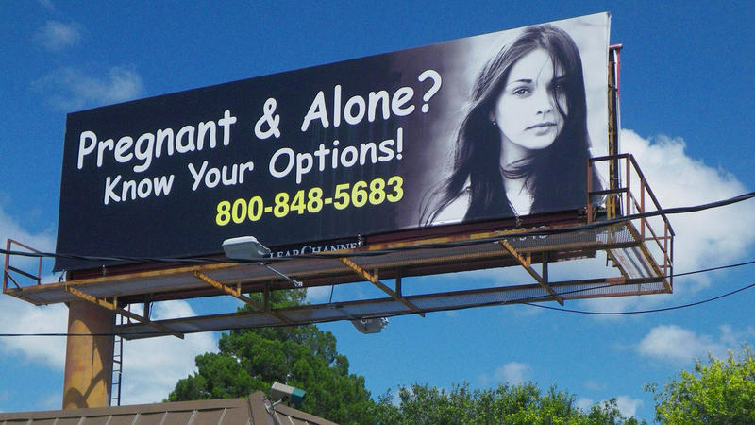
Background
CPCs are non-medical facilities which aim to prevent people from accessing an abortion
Provide some services
Some misinformation
Notes:
They provide counseling around an unintended pregnancy which is typically directed at convincing the person not to get an abortion. CPCs may provide some services, such as pregnancy testing, some provide ultrasounds, referrals for adoption, resources to help parents raise children (free diapers, etc).

Slide 3
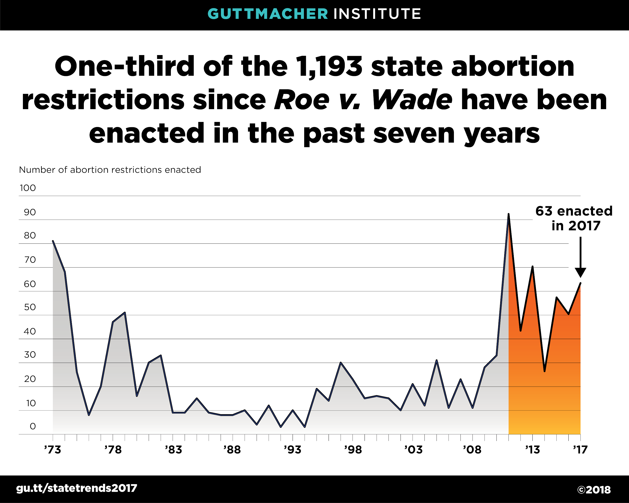

Slide 4
Research Question
How is the number of crisis pregnancy centers in a state affected by abortion provision within the state and health care coverage, controlling for political and demographic factors?

Slide 5
Validation
Validating variables
Validating findings: regression and robustness check

Slide 6

Dependent variable: number of crisis pregnancy centers in a state
Open source database with name, address, social media links
Only source I could find on CPCS: validation an issue

Slide 7
Independent variables
Abortion provision within the state
Presence/absence of laws regarding abortion
Number of abortion providers
Number of abortions provided
Health care coverage within the state
Medicaid expansion
Percent uninsured

Slide 8
Data sources for independent variables
Variable | Source | Year of data
Number of abortions provided by state | Guttmacher Institute | 2014
Number of abortion providers within state | Guttmacher Institute | 2014

Slide 9
Data sources for independent variables
Variable | Source | Year of data
Facility requirements | KFF (Guttmacher data) | 2018
Restrictions on gestational age |  | 2019
Mandatory ultrasounds |  | 2017
State policies |  | 2018
Waiting periods |  | 2018

Slide 10
Data sources for independent variables
Variable | Source | Year of data
Medicaid expanded | Kaiser Family Foundation | 2019
Uninsured rate | Kaggle: U.S. Department of Health and Human Services, Census | 2015

Slide 11
Control variables
Political and demographic factors within the state
Voting behavior (2012, 2016)
State population

Slide 12
Data sources for control variables
Variable | Source | Year of data
Voting behavior | Federal Elections Commission | 2012, 2016
State population | Kaiser Family Foundation (uses data from Census Bureau’s American Communities Survey) | 2017

Slide 13
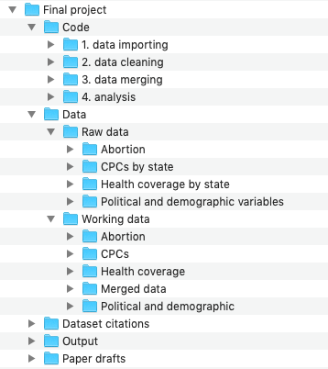
Data management
All data publicly available
Saving code, data, and output separately
I annotate my code clearly and separate files based on objective

Slide 14
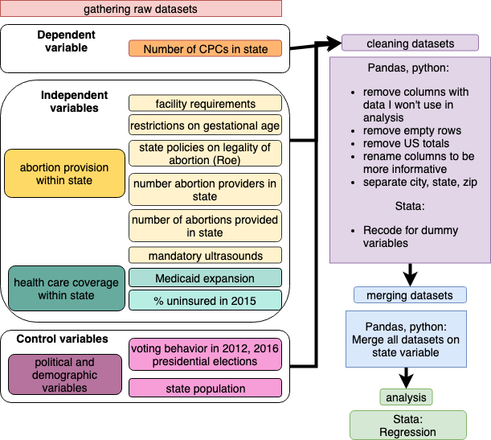

Slide 15
Findings
State election result in 2012 and 2016
Number of abortions provided and number of providers
Regulations not significant on their own but correlated with one another
Notes:
Include states’ GDP or political preference as a control

Slide 16
Limitations
Number CPCs by state
Laws not static

Slide 17
Discussion
Appears that CPCs are more prevalent in states with more abortion providers
Lack of regulations on CPCs makes them hard to measure
Next steps: composite measure for abortion regulation

Slide 18
Questions?

